Slide 1




Themable products
Barbara Hartel
Andreas Rößler
Product Expert, SAP SE
Principal Software Architect, SAP SE
with theming parameters and modern CSS
David Klug
Dominik Schreiber
Senior Developer, SAP SE
Principal Software Architect, SAP SE
Notes:
Notes David: Hi everyone I'm David and today I brought with me Barbara, Andreas and Dominik. We’re excited to be here at UI5con to talk about something that’s often overlooked but incredibly powerful: theming. You’ve probably seen it before when you looked at an application, that just look and feels right no matter what colors or corporate design the developer and designer choose. And then you might have thought: That must be a lot of work. But it doesn’t have to be. Today, we’ll show you how easy it is to make your product look great in every SAP theme.

Slide 2


Agenda
01
Why theming matters
02
How it was done
03
Use CSS custom properties
04
What could be next
Notes:
1: David
2: Andreas
3: Dominik
4: Barbara Notes David: Let's have a short look at our agenda. First I will outline WHY theming matters and why everyone should invest some time in theming their products. Then Andreas will show us HOW it was done in the past with LESS (and still could be done today). After that Dominik tell us to USE CSS custom properties with some modern CSS hacks. And in the end Barbara give use a short outlook WHAT could be next.

Slide 3

Why
theming matters
Notes:
David But let's start with the WHY. So why does theming matters? Let me come up with a simple example:
Well, think about people. We’re all different! In our personality, in preferences or in how we present ourselves. And just like people, products have personalities too.
Some of us wear a suit and tie, others wear a hoodie and sneakers. Not because one is better than the other, but because it fits the context, the role, the mood, or the individual.
So why should all products look the same?

Slide 4
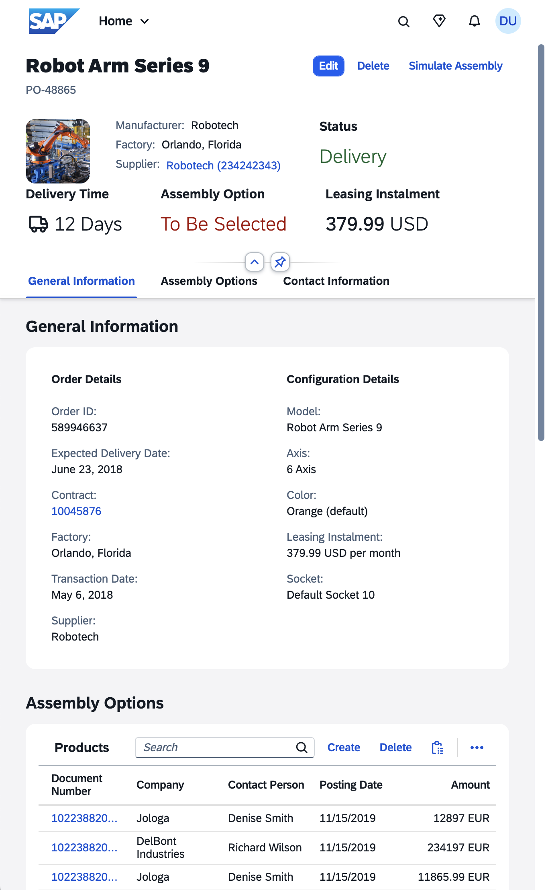
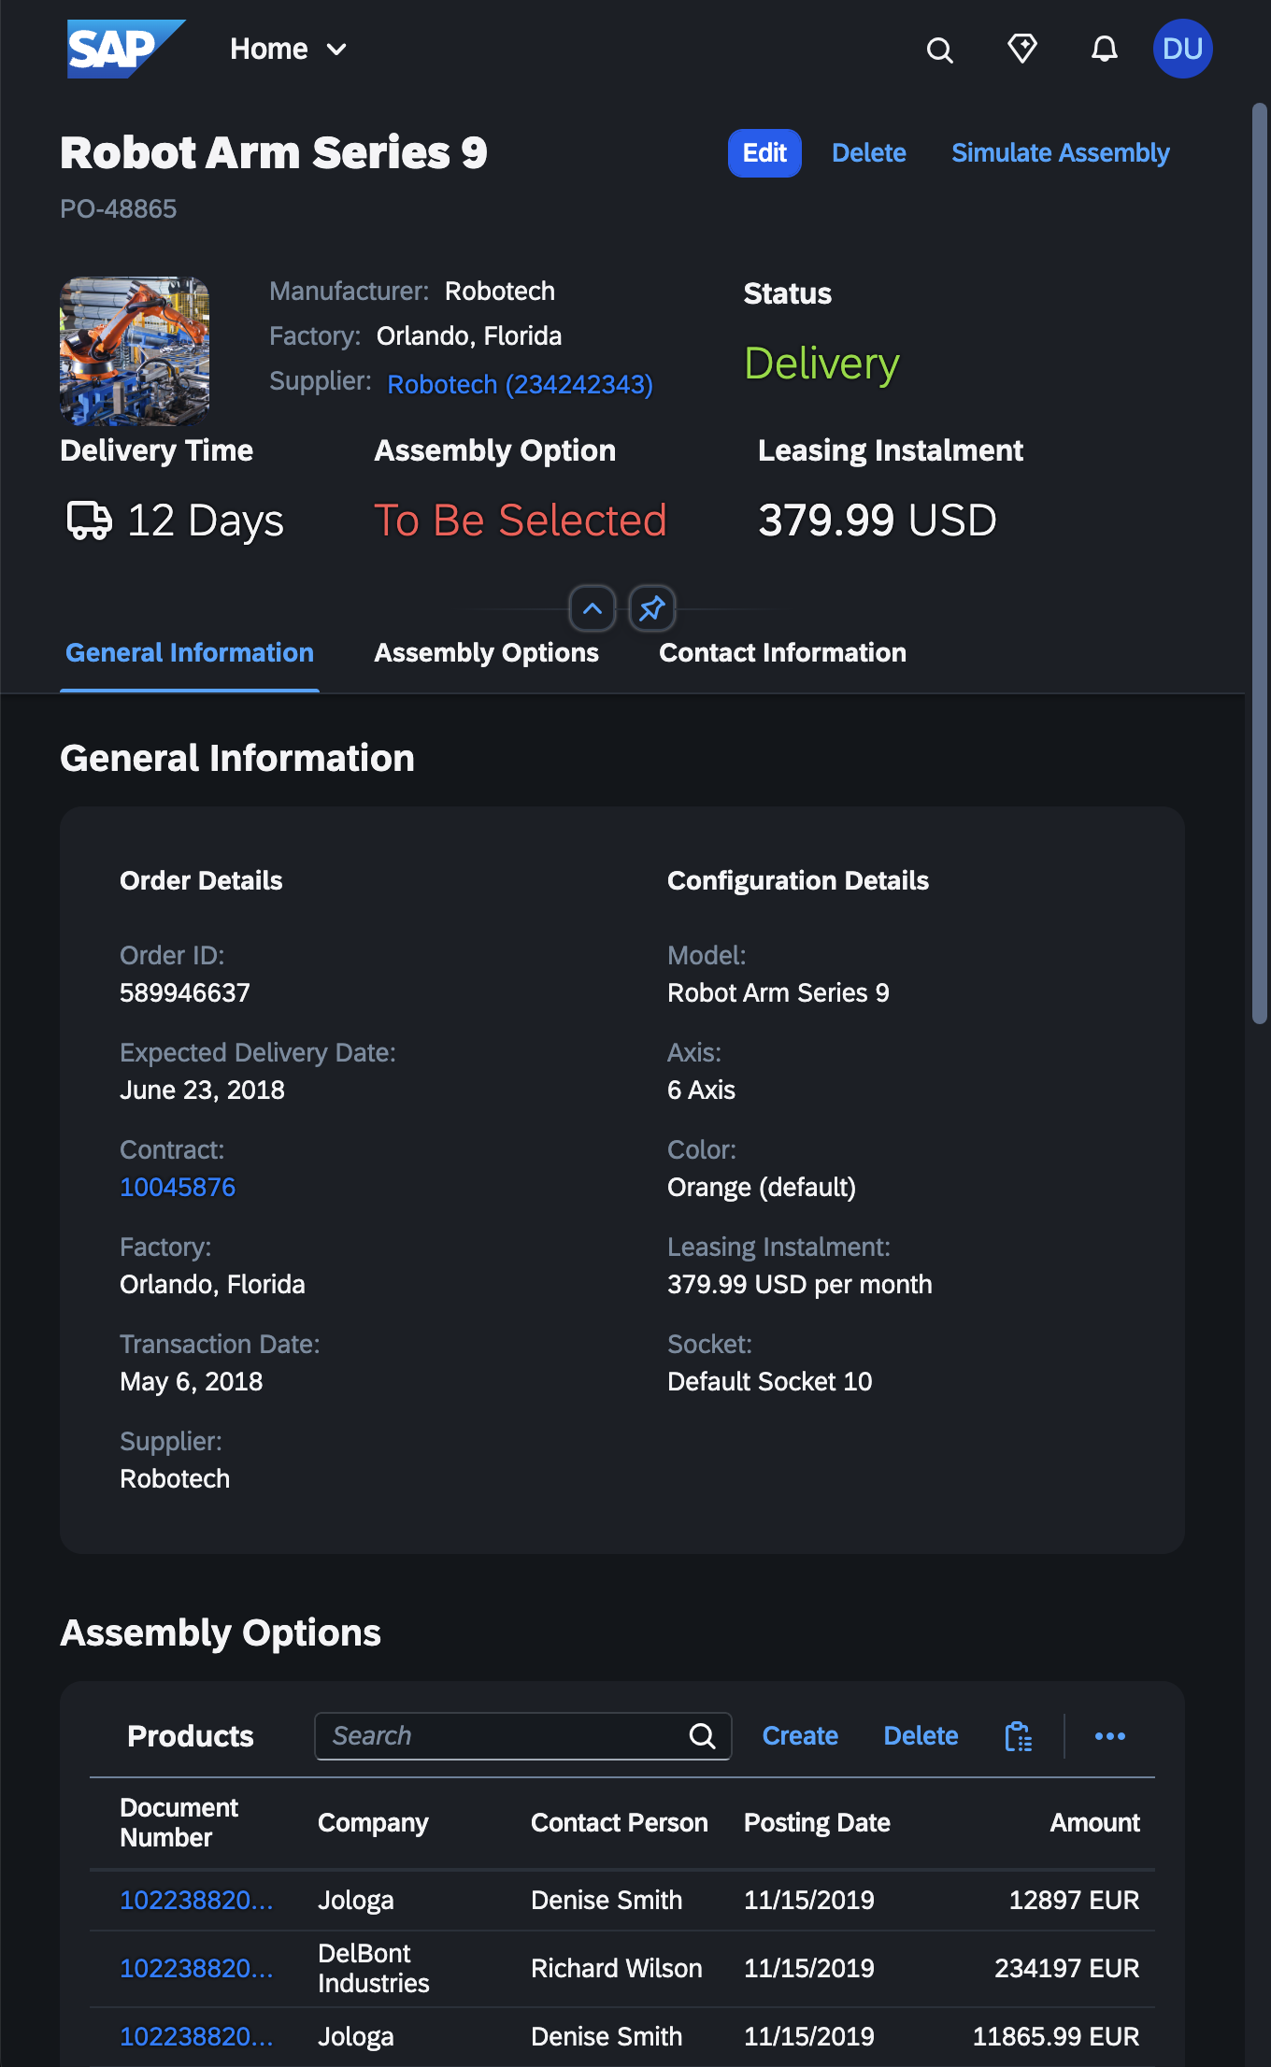
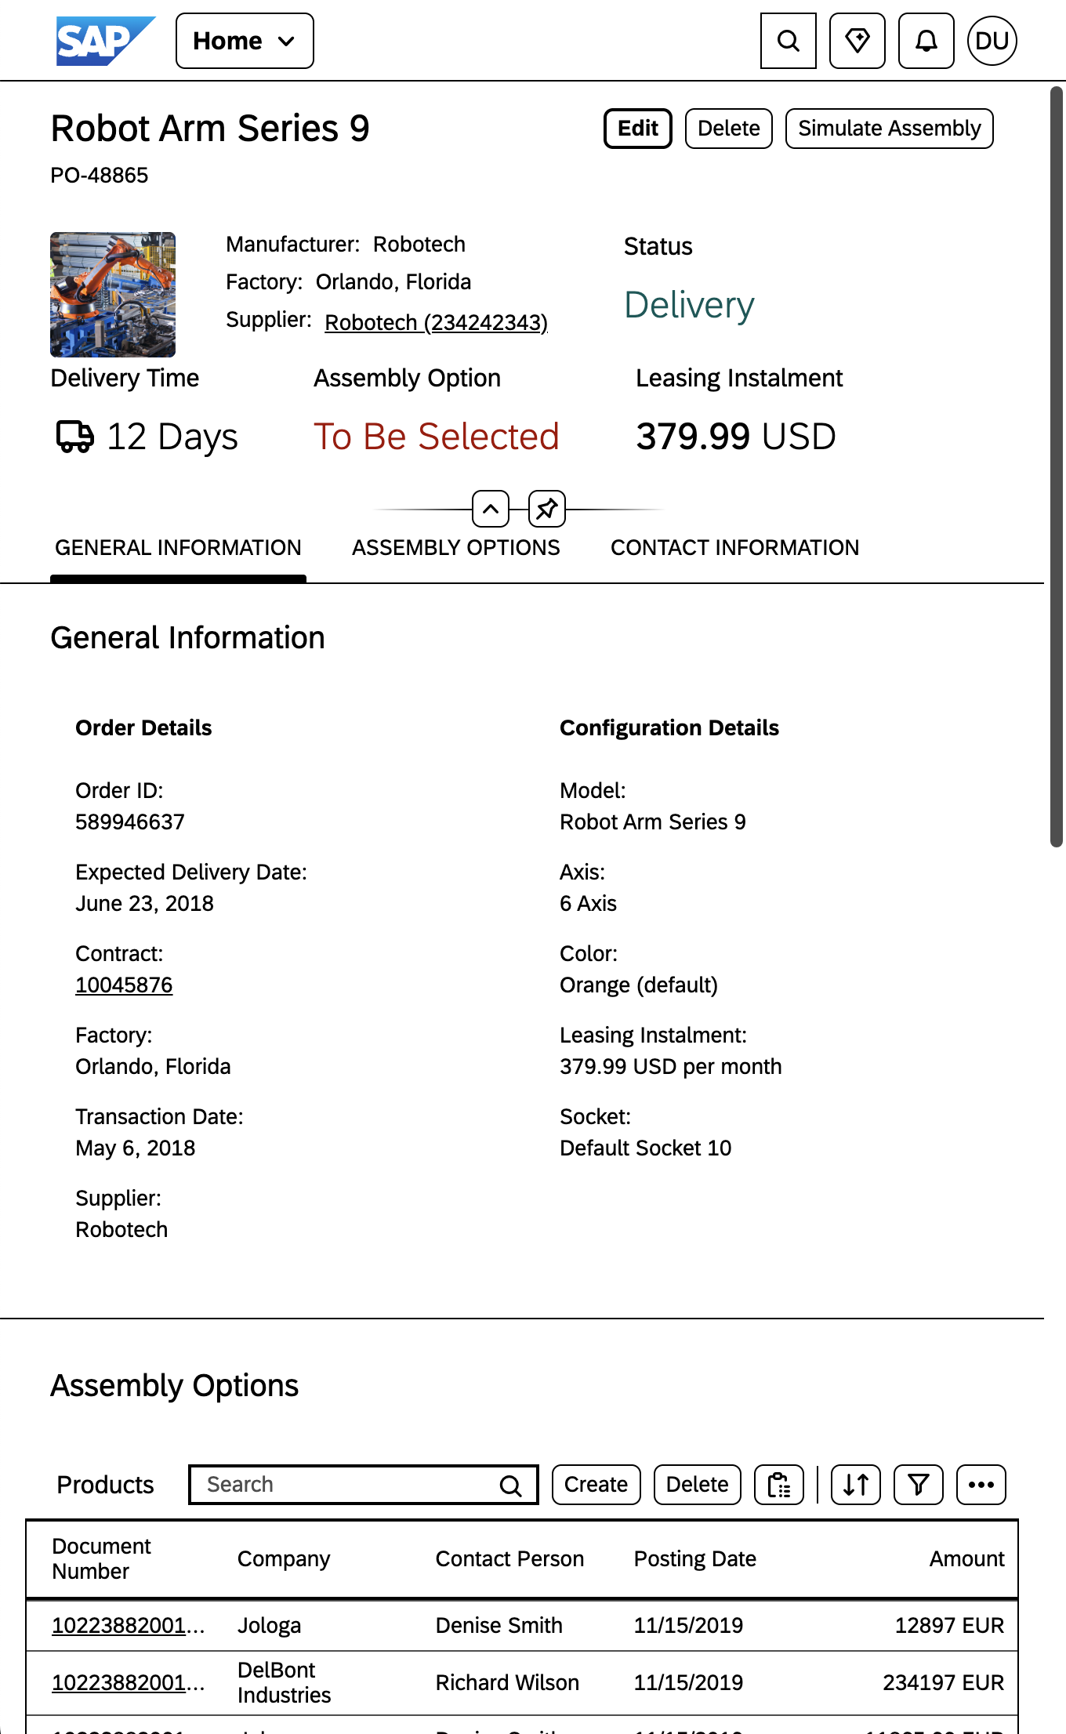
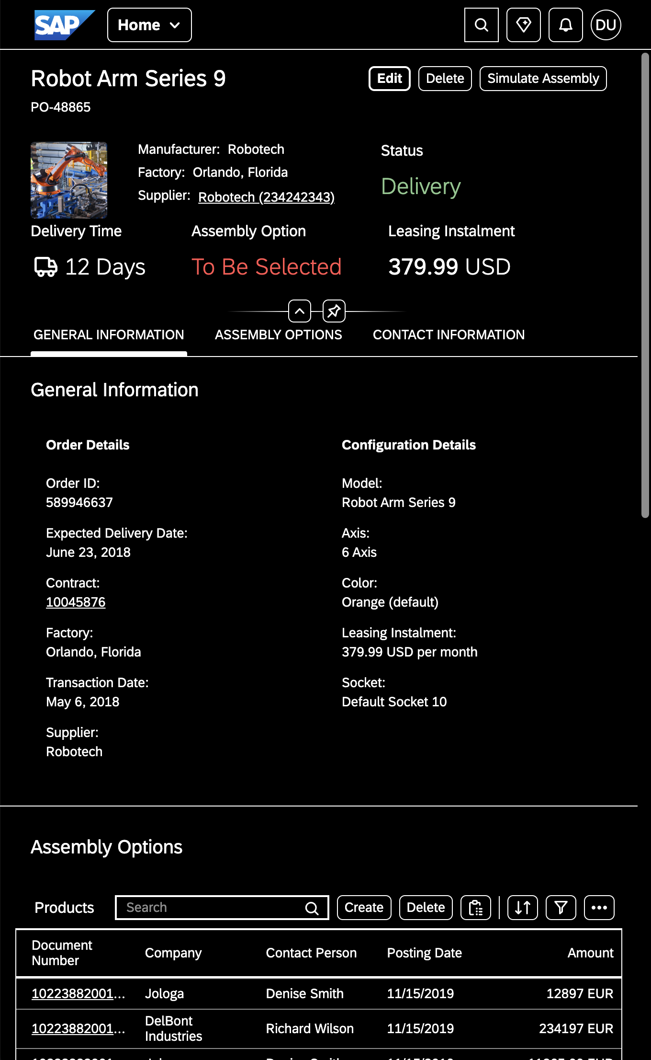
Notes:
And because of that SAP already comes up with four different theme flavours across our different theme families. We already provide a light and a dark mode and and a hig contrast white and high contrtast black mode. These are the theme flavors SAP provides out of the box. Now imagine what you can do with your own custom theme.

Slide 5
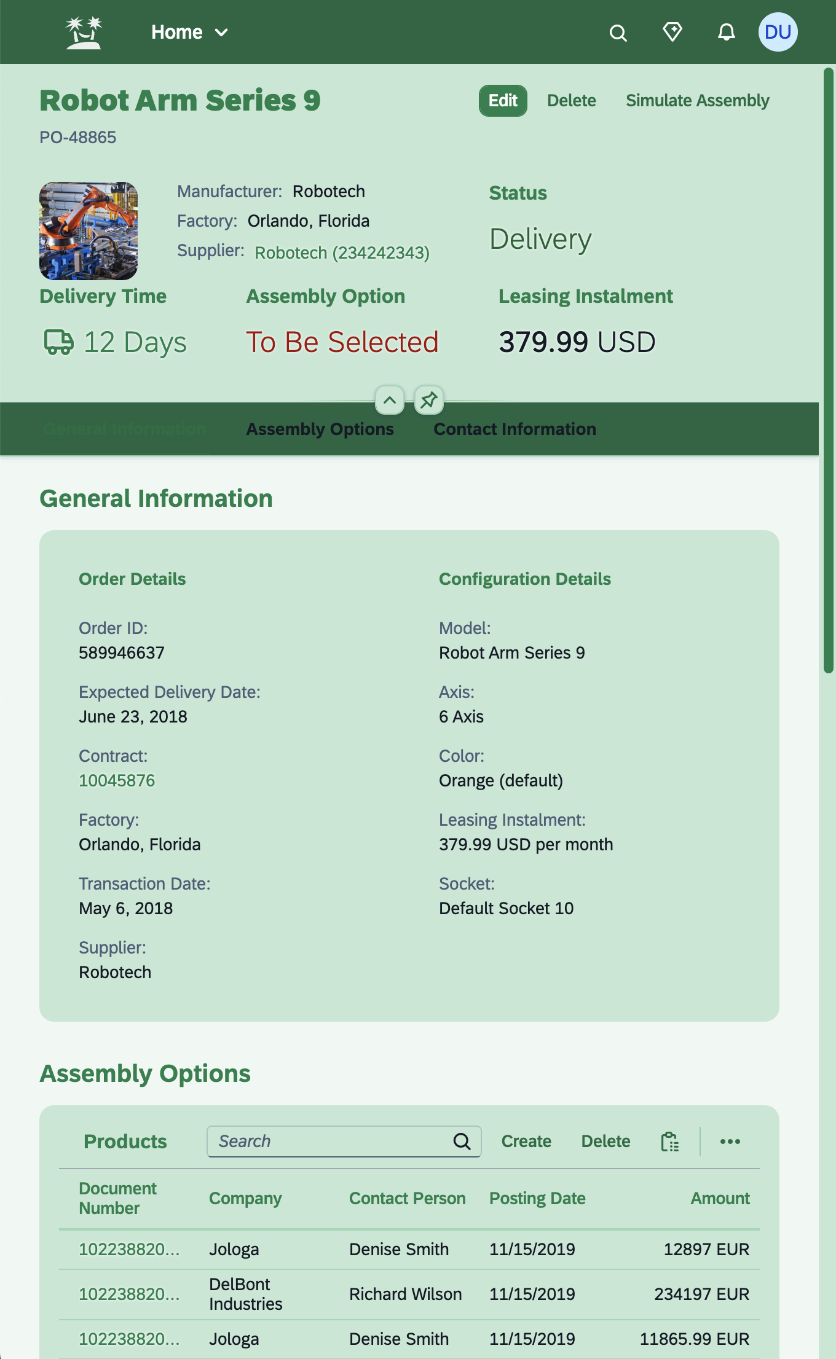
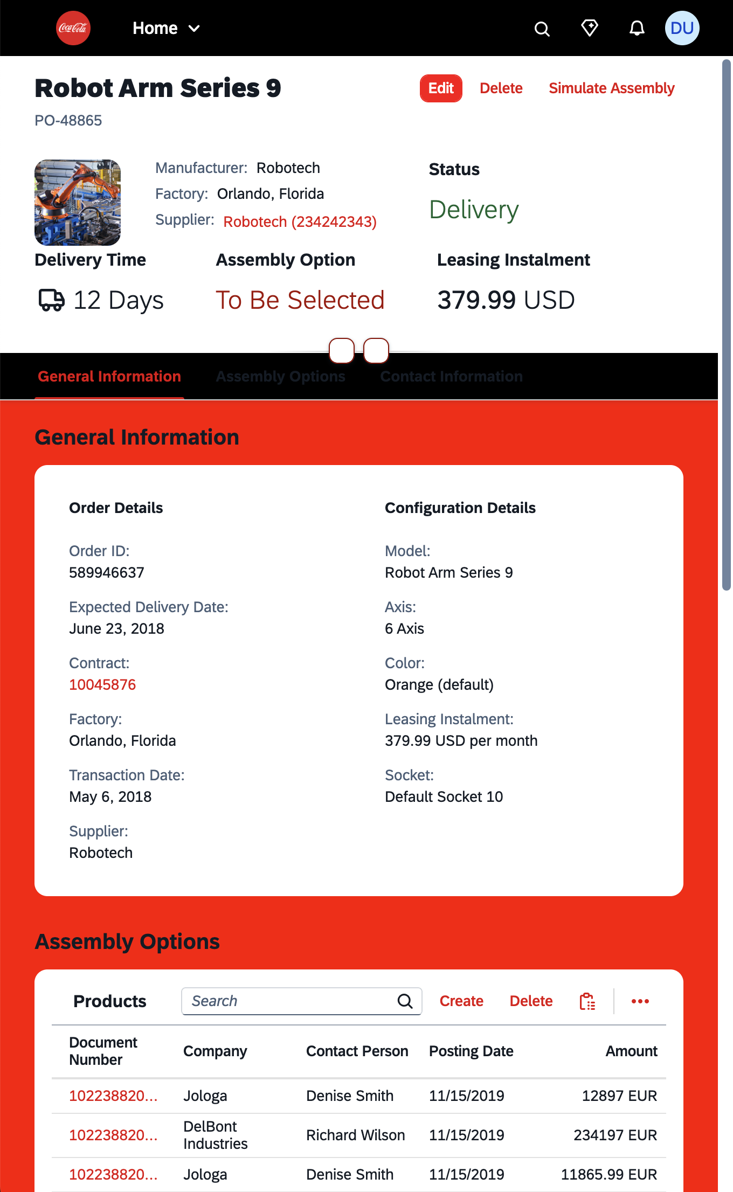
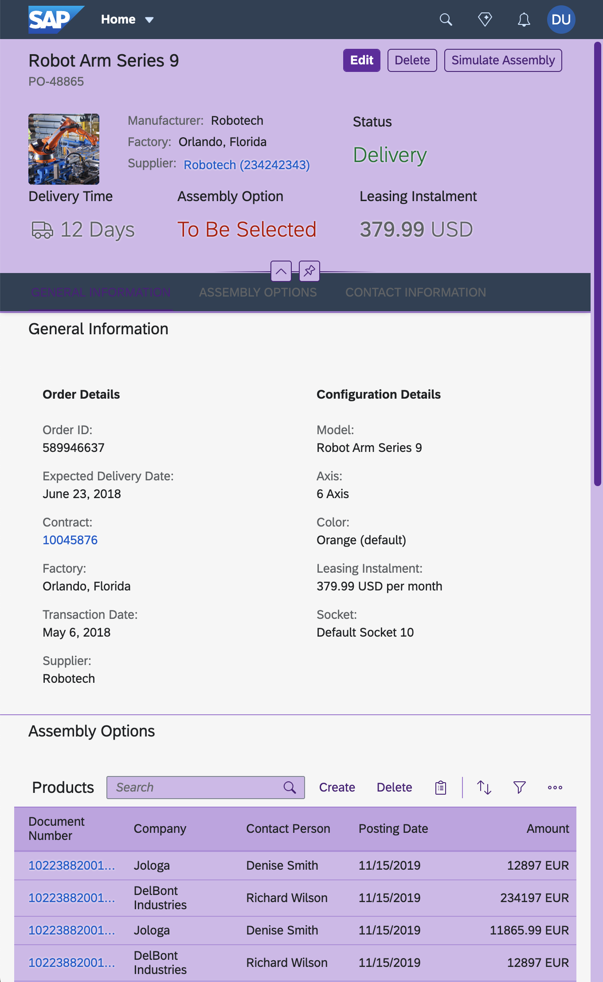
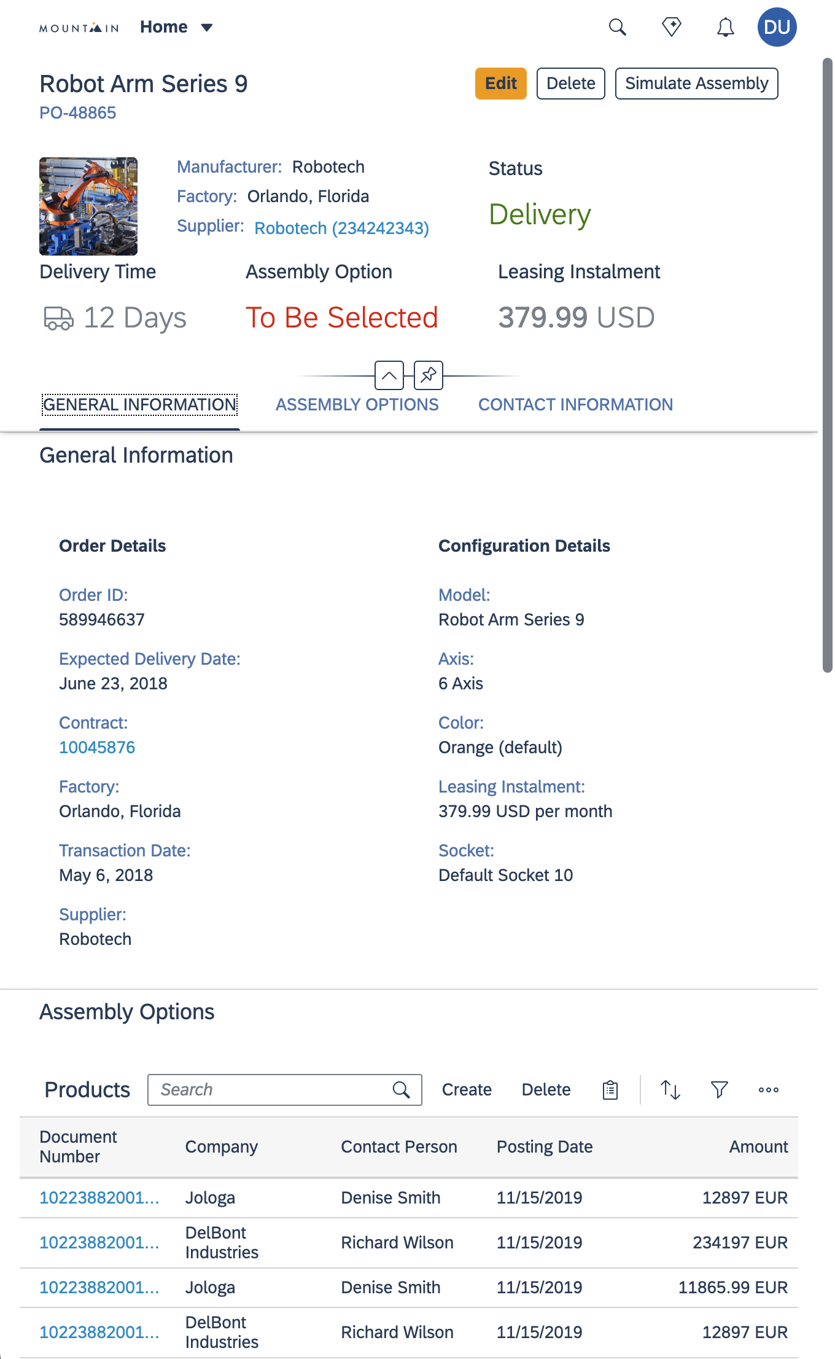
Notes:
On top of the SAP base themes, customers can build their own custom themes to match their brand, environment or a specific use case. An this gives you the power to make your applications truly stand out and shine. And now you think this will be a lot of work.

Slide 6
.homeButton { color: #131e29; border: none; }
.homeButton { color: #f5f6f7; border: none; }
.homeButton { color: #000; border: 1px solid #000; }
.homeButton { color: #fff; border: 1px solid #fff; }
Notes:
And yes, you’re right to think theming can be a lot of work… If you do it the wrong way. Without using SAP’s theming infrastructure.
Theming often meant writing a separate CSS file for every single theme flavor you wanted to support.
Just imagine, duplicating rules like these for every color scheme, just to style something as simple as a home button.

Slide 7
.homeButton { color: @color; border: @border; }
@color: #131e29; @border: none;
@color: #f5f6f7; @border: none;
@color: #000; @border: 1px solid #000;
@color: #fff; @border: 1px solid #fff;
Notes:
But with a more modern technique things are much simpler. You only need one CSS file for your application, no matter how many flavors you want to support.
And inside that single file, you can use CSS custom properties
For that you can use the theming parameters provided by SAP, to let the theme do the work.
No duplication, no hardcoding, no chaos.
But that was just a teaser. And now, my wonderful colleague Andreas will take over and show you how this actually works in practice.

Slide 8
How
it was done
Notes:
Andreas

Slide 9
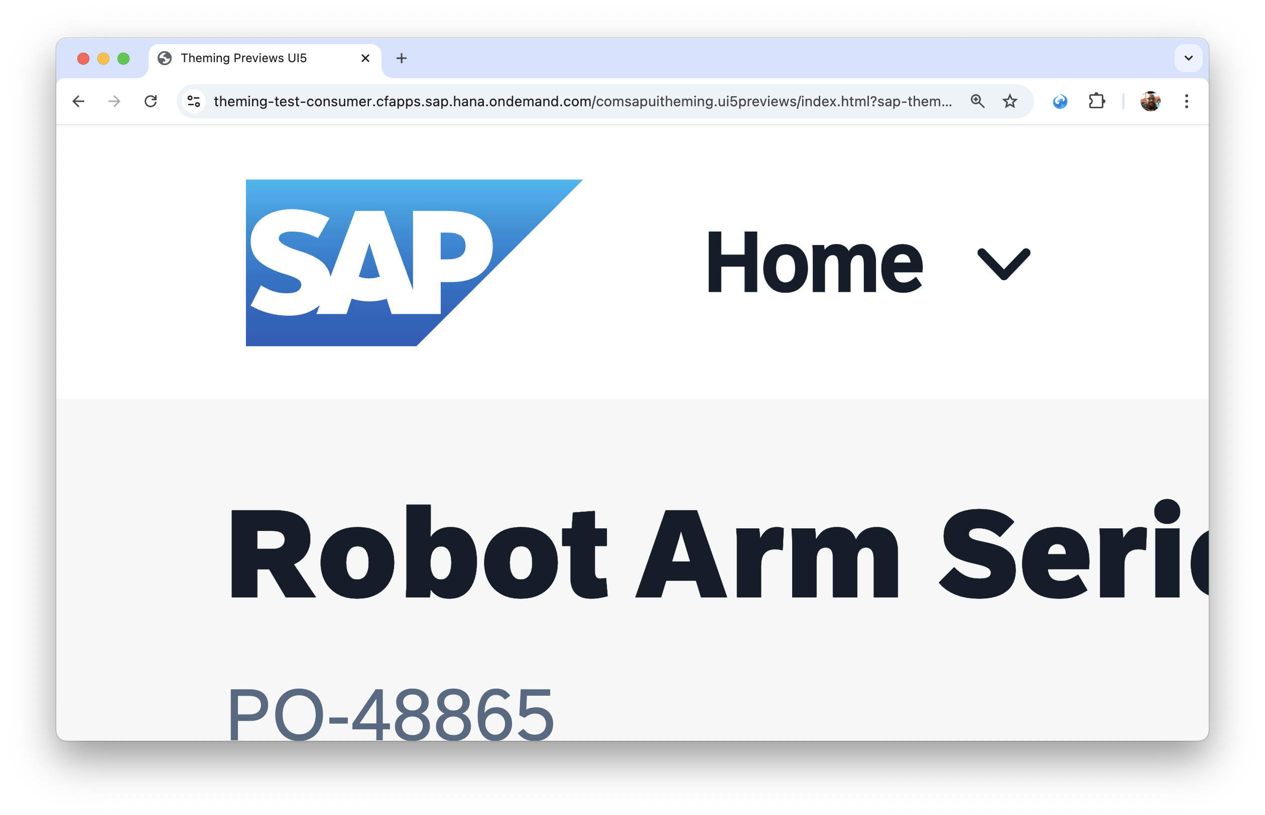
Easy solution: ignore theming

Slide 10
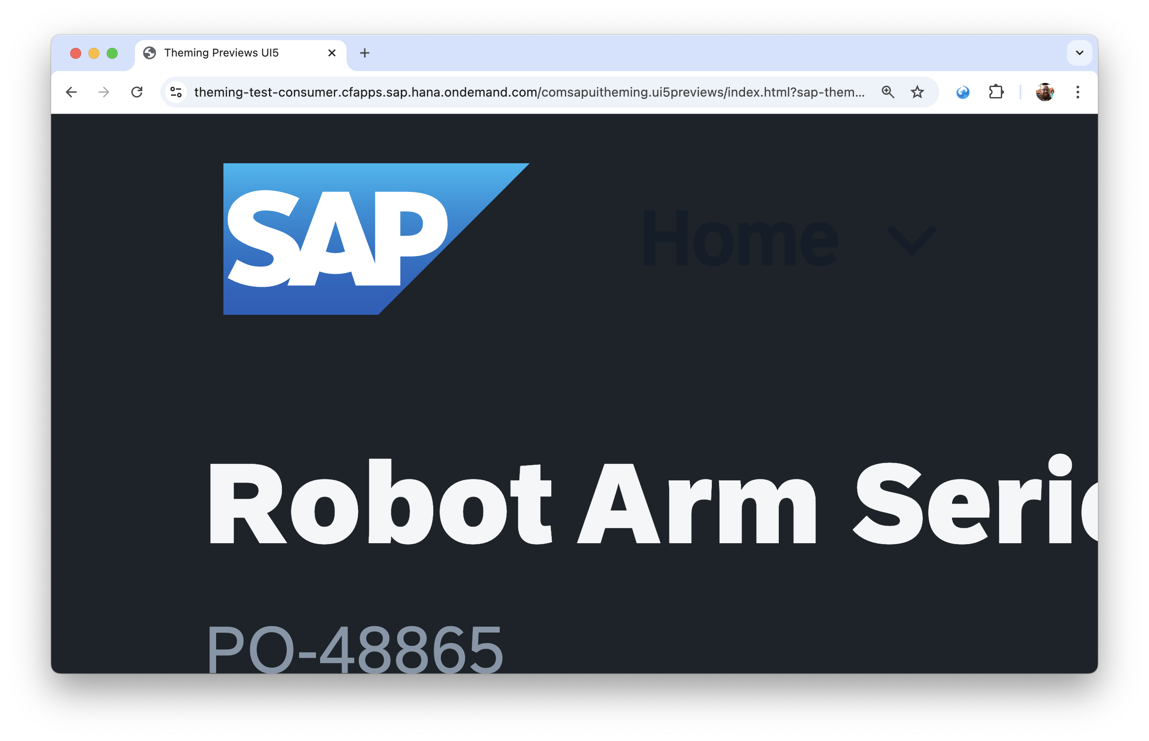
Easy solution: ignore theming
👎 BADBADNOTGOOD

Slide 11
Manual solution: use Parameters.get()
// control/HomeButton.ts import Theming from “sap/ui/core/Theming”; import Parameters from “sap/ui/core/theming/Parameters”; import Control from “sap/ui/core/Control”; function contrast(background: string, colorOnLight: string, colorOnDark: string, darkThreshold: number): string {/*…*/} export default class HomeButton extends Control { renderer = { render(rm: RenderManager, control: HomeButton) { const { sapShellColor, sapTextColor, sapContent_ContrastTextColor, sapContent_ContrastTextThreshold, sapHC_StandardForeground, sapButton_BorderWidth } = Parameters.get([ “sapShellColor”, “sapTextColor”, “sapContent_ContrastTextColor”, “sapContent_ContrastTextThreshold”, “sapHC_StandardForeground”, “sapButton_BorderWidth” ]) as Record<string, string>; rm.openStart(“button”, control); rm.style(“color”, contrast(sapShellColor, sapTextColor, sapContent_ContrastTextColor, sapContent_ContrastTextThreshold)); rm.style(“border”, Theming.getTheme().includes(“_hc”) ? `${sapButton_BorderWidth} solid ${sapHC_StandardForeground}` : “none”); rm.openEnd(); rm.close(“button”); } } }
⏱️ Sync fetch() in render()?

Slide 12
Best case: be part of the theming build
// themes/base/HomeButton.less @_myLib_HomeButton_TextColor: contrast(@sapShellColor, @sapTextColor, @sapContent_ContrastTextColor, @sapContent_ContrastTextThreshold); @_myLib_HomeButton_Border: none; .homeButton { color: @_myLib_HomeButton_TextColor; border: @_myLib_HomeButton_Border; } // themes/sap_horizon_hcb/HomeButton.less @_myLib_HomeButton_Border: @sapButton_BorderWidth solid @sapHC_StandardForeground;
🎨 Not for custom branding

Slide 13
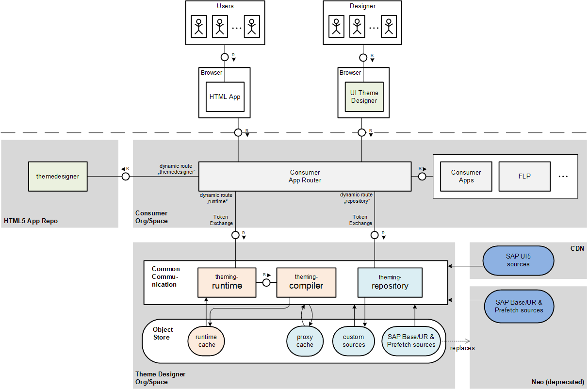
Detour: the theming service on SAP BTP

Slide 14
Use
CSS custom properties
Notes:
Dominik

Slide 15
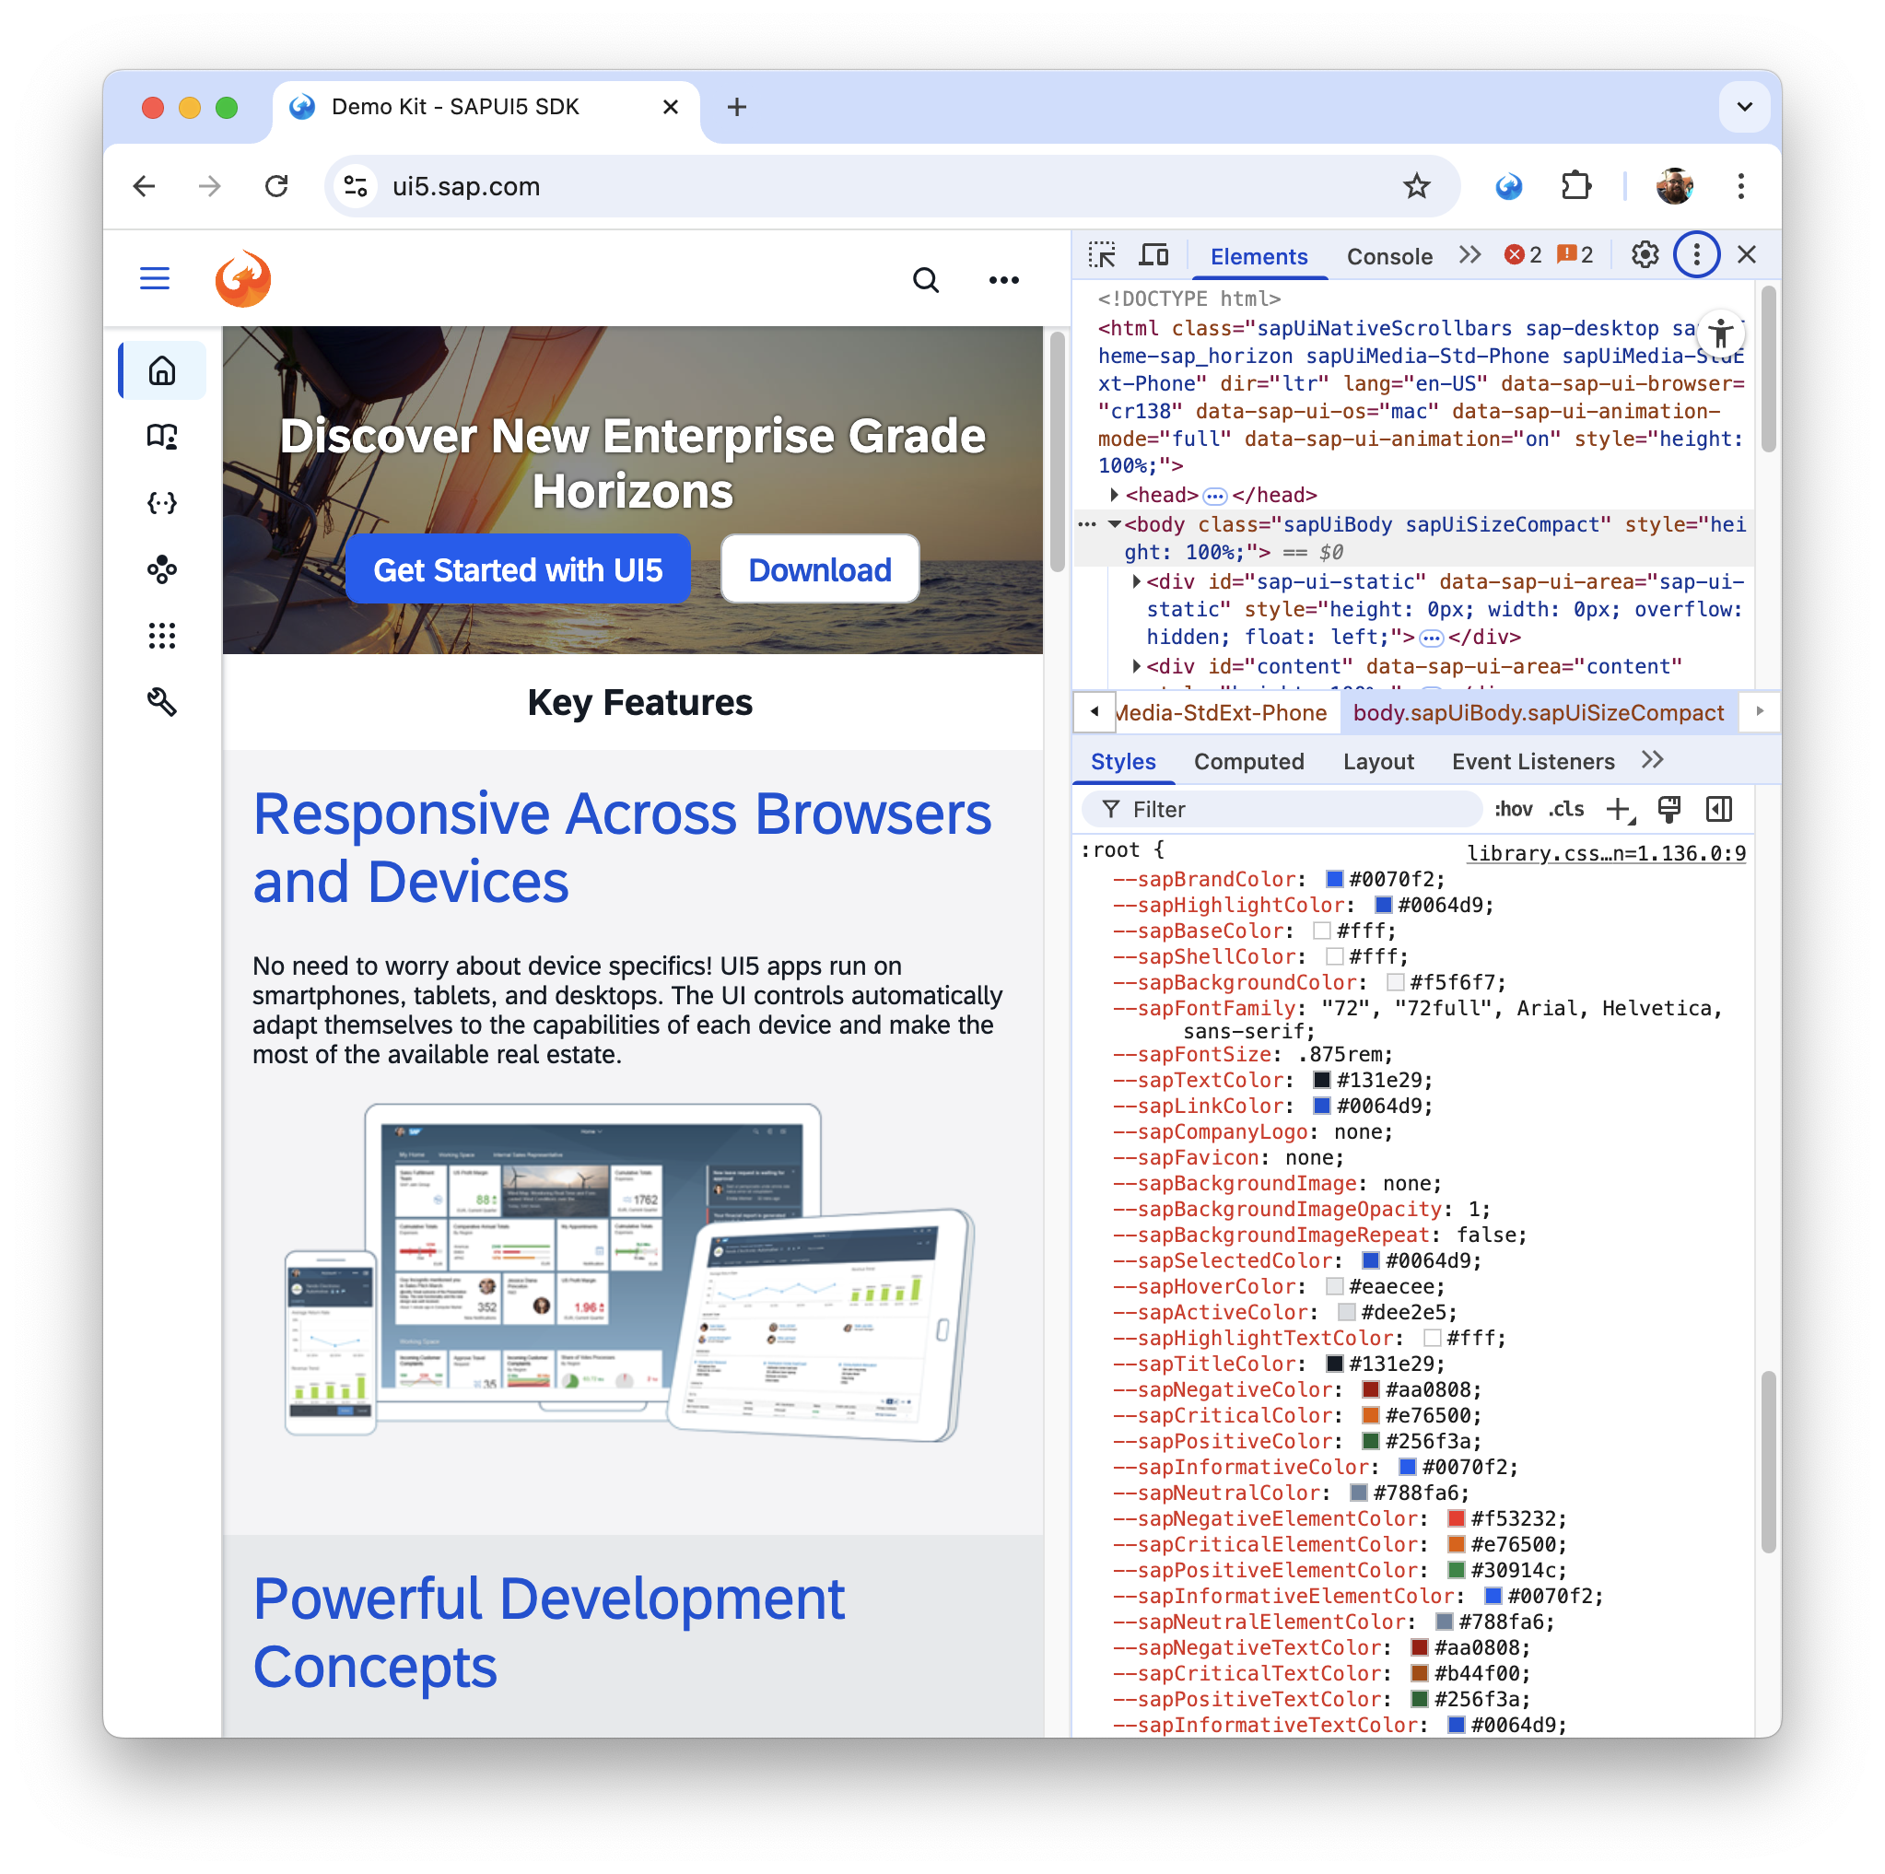
UI5 has custom properties since 1.127
And CSS is almost turing-complete
99% of the time you can use custom properties that are already there
Modern color spaces and relative colors replace color functions
Container style queries allow conditional CSS

Slide 16
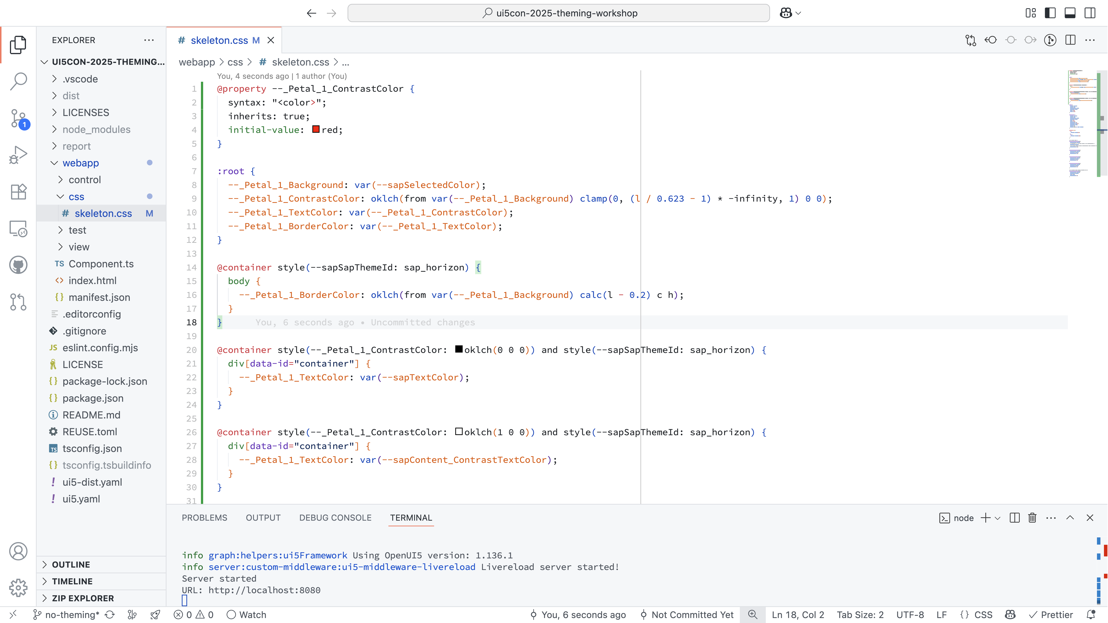
Demo
UI5 does it themselves Look at their controls
What a nice flower! Really?
Use existing custom properties
Derive colors with oklch(from var(…))
Theme-dependent CSS with --sapSapThemeId
Notes:
Nicht so oft zwischen Browser und Editor switchen
Flower Control zeigen
Tabs erklären
High-Contrast erklären
Nicht so stark auf clamp() eingehen, nur Link auf Mechanismus
oklab(… l c h) erklären

Slide 17
What
could be next
Notes:
Barbara
Expert Corner 13:25-14:45
Workshop 15:55-17:25 orange room

Slide 18
A Vision of what is now possible
Every application, every control can work in every theme
The logic of themes can be expressed in CSS custom properties
Parts of applications can be themed differently; we have real “scopes”
The theming service can be shut down; we’ve made ourselves obsolete

Slide 19
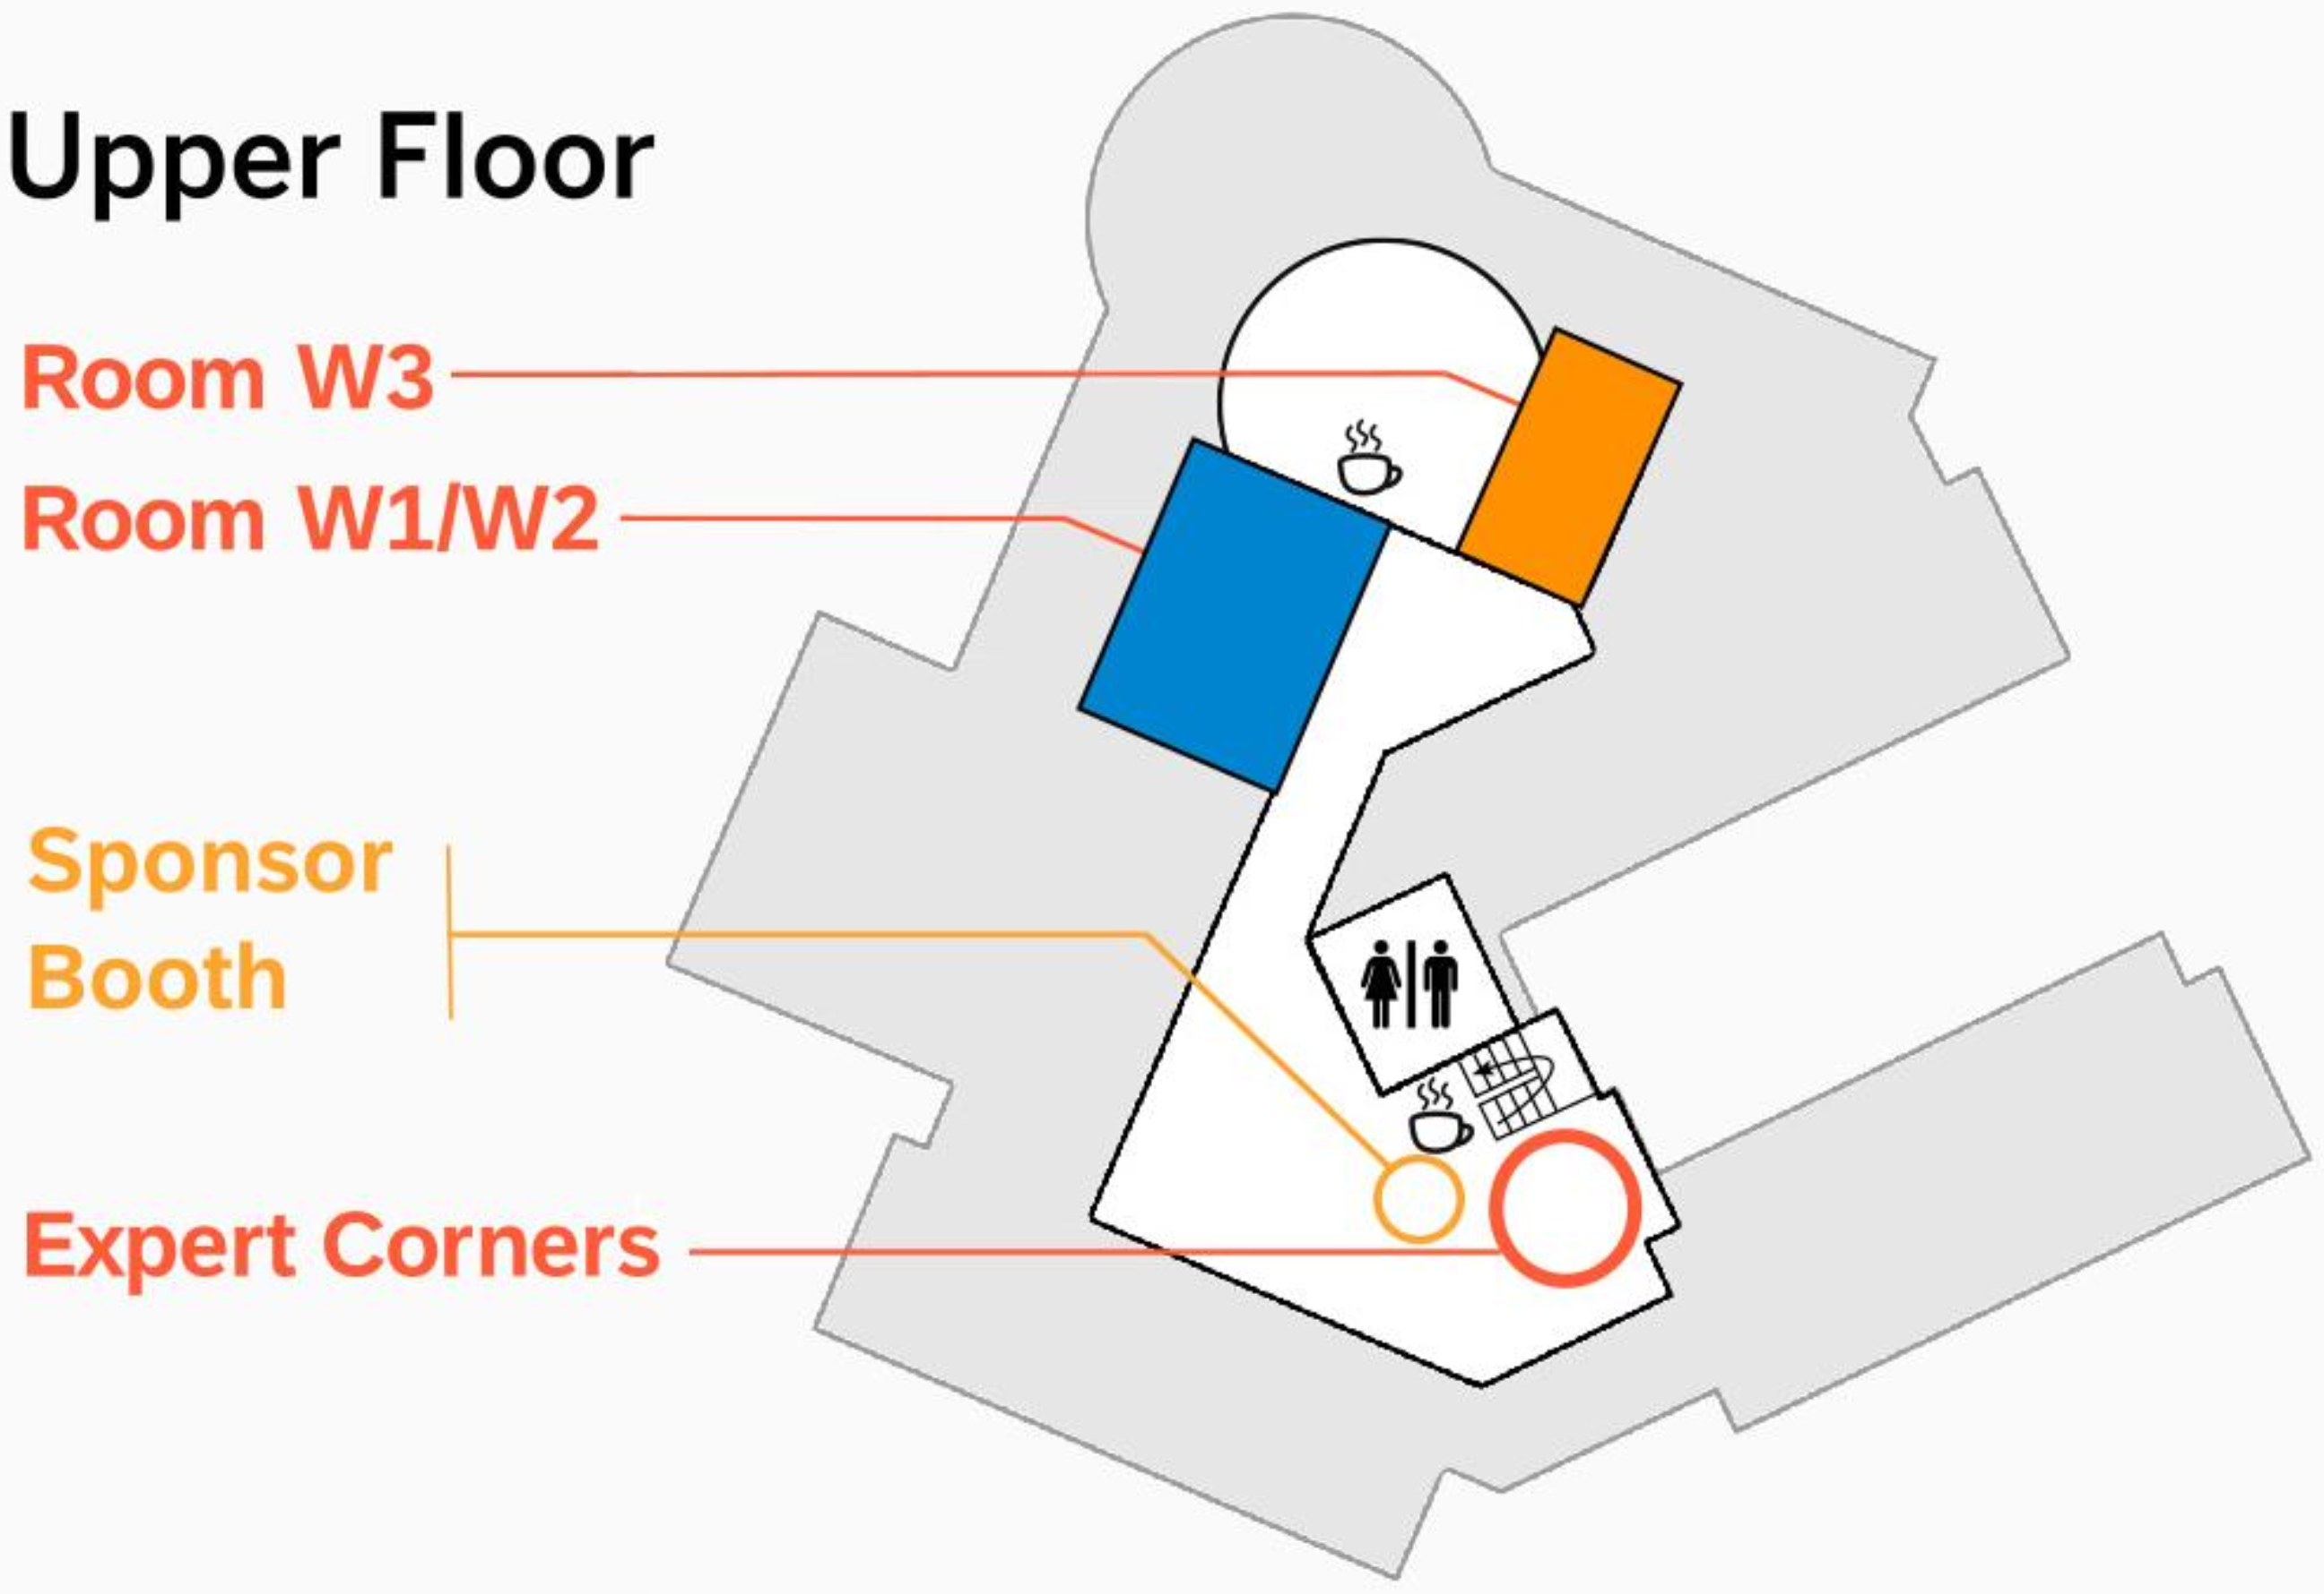
More theming today
You are here
15:55
13:25
13:25-14:45 Expert Corner
Talk to us about your theming experience
15:55-17:25 Workshop in the Orange Room
Bring your own project, or use a starting point from SAP-samples/ui5con-2025-theming-workshop

Slide 20
Thank you
Barbara Hartel
Andreas Rößler
@bhartel
Go, build something amazing!
David Klug
Dominik Schreiber
@dominikschreiber

Slide 21


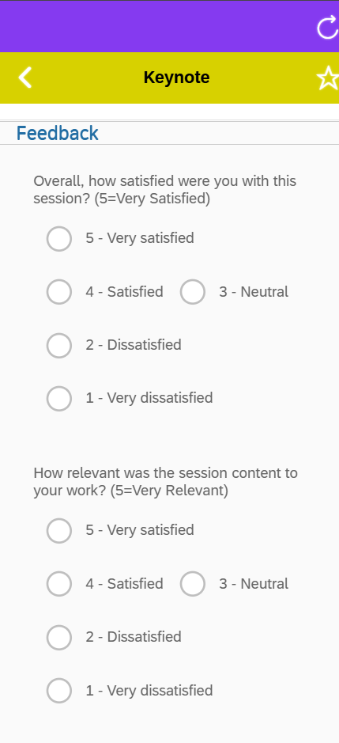

Got feedback? Let’s hear it!
Themable Products with theming Parameters and modern CSS

